Slide 1
TNE20002 / TNE70003
Topic 11 IPV6 V1.0

Slide 2
Why We Need More Address Space
The IPv4 address space provides approximately 4,294,967,296 unique addresses.
Only 3.7 billion addresses are assignable.
Separates the addresses into classes.
Reserves addresses for multicasting, testing, and other specific uses.
Despite the large number, IPv4 address space has run out.

Slide 3
Why is IPv4 Address Space Shrinking?
Population Growth:
The Internet population is growing.
Users stay on longer.
Reserve IP addresses for longer periods.
Contacting more and more peers daily.
Mobile Users:
Mobile idevices need an iP address – itablets, ipads, ilaptops, iphones

Slide 4
Why is IPv4 Address Space Shrinking?
Transportation:
More than one billion automobiles
Newer models are IP-enabled to allow remote monitoring.
Consumer Electronics:
The newest home appliances allow remote monitoring using IP technology.
e.g. Digital Video Recorders (DVRs) that download and update program guides.
Home networking.

Slide 5
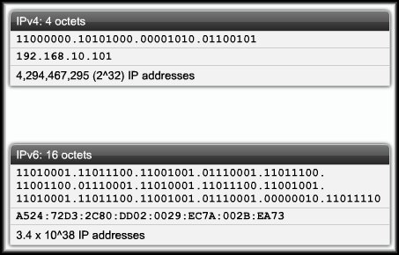
Reasons for Using IPv6
The ability to scale networks for future demands requires a limitless ? supply of IP addresses.
IPv6 satisfies the increasingly complex requirements of hierarchical addressing that IPv4 does not provide.

Slide 6
Reasons for Using IPv6
Address Availability:
IPv4: 4 octets - 32 bits
2^32 or 4,294,467,295 IP Addresses.
IPv6: 16 octets - 128 bits (32 hexadecimal)
3.4 x 10^38 or
340,282,366,920,938,463,463,374,607,431,768,211,456
(340 undecillion) IP Addresses.
Every atom of every person on Earth could be assigned 7 unique addresses with some to spare (assuming 7 × 10²⁷ atoms per human x 7 Billion humans).

Slide 7
In
each
square metre of the planet
we can allocate
665,570,793,348,866,943,898,599
IPv6 addresses

Slide 8
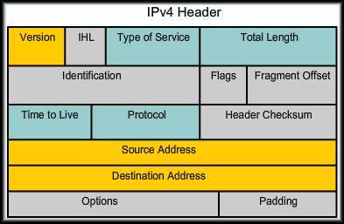
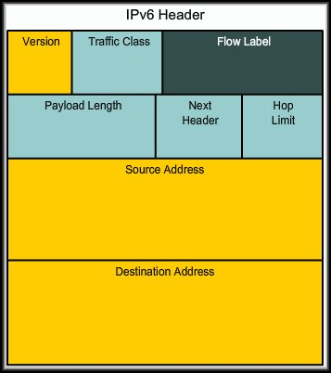
IPv6 vs IPv4 Header

Slide 9
IPv6 vs IPv4 Packet Header
Deleted Fields
IHL, Identification, Flags, Fragment Offset, Header Checksum (will this affect performance ?)
Renamed Fields
Type of Service -> Traffic Class (8 bit)
Total Length -> Payload Length (16 bit)
Protocol -> Next Header (8 bit)
Time to Live -> Hop Limit (8 bit)
New Field - Flow Label (20 bit)
Source can tag the packet as being part of a specific flow, allowing routers to handle traffic on a per-flow basis rather than per-packet

Slide 10
IPv6 Addressing
IPv6 Global Unicast Address
equivalent to
IPv4 public address

Slide 11
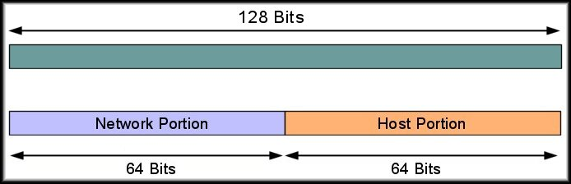
IPv6 Global Unicast Addressing
A unicast address is an address that identifies a single device.
A global unicast address is a unicast address that is globally unique.
Can be routed globally with no modification.

Slide 12
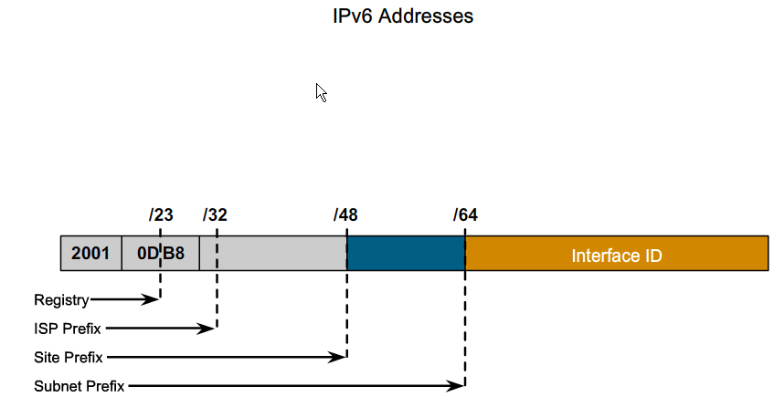
IPv6 Global Unicast Addressing
IPv6 has an address format that enables aggregation upward eventually to the ISP.
Global unicast addresses consists of a 48-bit global routing prefix and a 16-bit subnet ID.
Individual organizations can use a 16-bit subnet field to create their own local addressing hierarchy.
IANA - Internet Assigned Numbers Authority
Global Routing Prefix /48

Slide 13
IANA - Internet Assigned Numbers Authority
The global unicast addresses are assigned by the IANA using a range of addresses
Currently the Range 2001::/16 to 2FFF::/16 is allocated to the five Regional Internet Registries (RIRs)
4096 blocks (16x16x16)

Slide 14
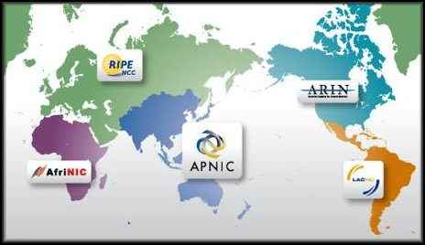
IPv6 Addressing - RIRs
Regional Internet Registries
AfriNIC | Africa region
APNIC | Asia and Pacific region
ARIN | Canada, many Caribbean and North Atlantic islands, and the United States
LACNIC | Latin America and parts of the Caribbean
RIPE NCC | Europe, Parts of Asia and the Middle East

Slide 15
Hierarchical Addressing

Slide 16
IPv4 – Address Hierarchy
External to Company 2 Levels
Class A N.H.H.H
Class B N.N.H.H
Class C N.N.N.H
Internal using VLSM Subnetting can have ? Levels
Class A N.S.S.SH
Class B N.N.S.SH
Class C N.N.N.SH

Slide 17
IPv6
The END of VLSM ?

Slide 18
IPv6 Global Unicast Addressing – 6 Levels
Registry
7 bits
128
IANA
Space
allocated
12 bits
2001::/16 to 2FFF::/16
4096 Blocks
Company
16 bits
65,536
Subnet
16 bits
65,536
Host
64 bits
ISP
9 bits
512
18,446,744,073,709,551,616
Hosts
IANA - Internet Assigned Numbers Authority

Slide 19
IANA Address Space Current – EUI 64
Currently allocated 2001 to 2FFF, 2**12 = 4096 blocks
Block 2001 alone provides:
128 * 512 * 65536 = 4,294,967,296 company addresses
Each company can have 65356 subnets
Each subnet can have 18,446,744,073,709,551,616 hosts

Slide 20
IPv6 vs IPv4 Addressing Representation
Characteristic | IPv4 | IPv6
Format | x.x.x.x 4, 8-bit fields Separated by dots | x:x:x:x:x:x:x:x 8, 16-bit fields Separated by colons
Field Representation | Decimal Format | Groups of 4 hexadecimal digits, non case sensitive for A, B, C, D, E and F.
Leading Zeroes | Omitted | Optional
Successive Zero Fields | Must be included | Can be represented by “::” once in an address.

Slide 21
IPv6 Addressing – Unicast Hierarchy
2001: 0DB8:0001:0001:0290:27FF:FE3A:9E9A
Current IANA Allocated Space for Registries: 2001::/16 but 12 bits allocated
Registry Space Address Id/Prefix: 2001:0D00::/23 7 bits allocated for Registers
ISP Address Id/Prefix: 2001:0DB8::/32 9 bits allocated for ISPs
Site (eg Company) Address Id/Prefix: 2001:0DB8:0001::/48 16 bits allocated for Sites
Subnet Address Id/Prefix: 2001:0DB8:0001:0001::/64 16 bits allocated for Subnets
Host Address Id/Prefix:
2001:0DB8:0001:0001:0290:27FF:FE3A:9E9A/64 64 bits allocated for Hosts

Slide 22
IPv6 Addressing
Representation
Rules

Slide 23
IPv6 Addressing Representation Rules
Rule 1:
The leading 0s in a field are optional.
Rule 2A:
Successive fields of 0 can be represented as two colons ::
Rule 2B:
Rule 2A can only be applied once in an address

Slide 24
IPv6 Addressing Representation Rules
2001:0000:130F:0000:0000:09C0:876A:130B
Rule 1:
The leading 0s in a field are optional.
2001:0000:130F:0000:0000:09C0:876A:130B
0000 fields equal 0, 09C0 field equals 9C0
2001:0:130F:0:0:9C0:876A:130B

Slide 25
IPv6 Addressing Representation Rules
Rule 2A:
Successive fields of 0 can be represented as two colons ::
2001:0:130F:0:0:9C0:876A:130B
2001:0:130F::9C0:876A:130B

Slide 26
IPv6 Addressing Representation Rules
Rule 2B:
Rule 2A can only be applied once in an address
Example: 2001::FA01::BC31
Ambiguity ?
2001:0000:0000:FA01::BC31
OR
2001::FA01:0000:0000:BC31

Slide 27
IPv6 Addressing - Applying the Rules
2001:0000:0000:0000:01F4:00C8:C0A8:0420
2001:0501:0008:0000:0260:07FF:FE40:EFAB
2001:00F0:0000:0000:0145:0000:0000:00AB

Slide 28
IPv6 Addressing – Unicast Hierarchy
Given the IPV6 Address:
2001: B00:C18:2:1F:AAEQ:1:2
1. Fully expand the Address
2. What is the subnet (LAN) address Id/Prefix?
3. What is the company (Site) address Id/Prefix?
4. What is the Registry Space address Id/Prefix?

Slide 29
IPv6 Addressing
Unspecified Addresses (::/128):
In IPv4, an IP address of all zeroes (0.0.0.0):
It is used by a device in request to a DHCP server to have its IPv4 address configured
In IPv6, an IP address of all-zeroes address (0000:0000:0000:0000:0000:0000:0000:0000):
It is used by a device in request to a DHCP server to have its IPv6 address configured

Slide 30
IPv6 Addressing
Loopback Address (::1/128):
Just as in IPv4 (127.0.0.1), a provision has been made for a special loopback IPv6 address for testing local IPv6 stack
Packets sent to this address "loop back" to the sending device.
In IPv6 there is just one address, not a whole block, for this function.

Slide 31
Addresses
the
First
16 bits
0000 to FFFF

Slide 32
IPv6 Address Space
Address Type | High Order Bits (Binary) | High-Order Bits (Hex)
Unspecified | 00…0 | ::/128
Loopback | 00…1 | ::1/128
Multicast | 11111111… | FF00::/8
Link Local Unicast | 1111111010 | FE80::/10
Global Unicast | 0010 or 0011
Reserved (Future Global unicast) | Everything Else

Slide 33
IPv6 Addressing – FE80::/10
Link Local Address FE80::/10 to FEB0::/10
Have a first octet value FE then third hexadecimal digit 8 to B
FE8, FE9, FEA, FEB
These addresses refer only to a particular physical link.
Routers do not forward packets using link-local addresses.
They are only for local communication on a particular physical network segment (LAN).
Dynamically created on all IPv6 interfaces
They are used for link communications
Automatic address configuration.
Neighbor discovery.
Router discovery.
IPv6 Routing Protocols.

Slide 34
IPv6 Addressing
Multicast Address FF00::/8
A multicast address identifies a multicast group (set of devices).
A packet being sent to a multicast group is originated by a single device.
A multicast packet normally has a unicast address as its source address and a multicast address as its destination address.
A multicast address never appears in a packet as a source address.
There is no reserved broadcast address like IPv4.

Slide 35
IPv6 Addressing
Multicast Address(FF00::/8):
Examples of well-known IPv6 Multicast Addresses
FF02 – 1111111100000010::A in reserved range FF00::/16 to FF0F::/16
Address | Multicast Group
FF02::1 | All Nodes
FF02::2 | All Routers
FF02::5 | OSPFv3 Routers
FF02::6 | OSPFv3 Designated Routers
FF02::9 | RIPng Routers
FF02::A | EIGRP Routers
FF02::B | Mobile Agents
FF02:C | DHCP Servers / Relay Agents
FF02::D | All PIM Routers

Slide 36
IPv6 Address Management
Four methods of address assignment:
Static assignment to an interface
Static assignment using an EUI-64
Dynamic Stateless Autoconfiguration.
Dynamic DHCP for IPv6 (DHCPv6)

Slide 37
IPv6 Address Management
Static assignment to an interface
To configure an IPv6 address on a Cisco router interface, use the ipv6 address command in interface configuration mode.
interface G0/0/1
ipv6 address 2001:DB8:2222:7272::72/64

Slide 38
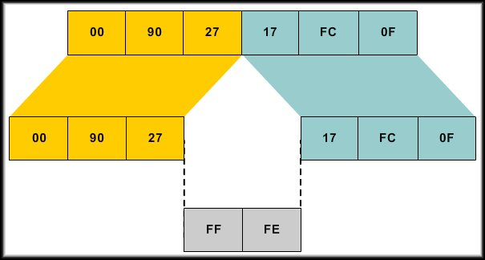
IPv6 Address Management
Manual assignment using an EUI-64 interface ID.
The EUI-64 standard explains how to stretch IEEE 802 MAC addresses from 48 to 64 bits by inserting the 16-bit 0xFFFE in the middle at the 24th bit of the MAC address to create a 64-bit, unique interface identifier.
interface G0/0/1
ipv6 address 2001:DB8:2222:7272::/64 eui-64

Slide 39
IPv6 Address Management
Static assignment using an EUI-64 interface ID.
MAC address
Insert

Slide 40
Creating EUI-64 Interface ID
Ethernet Mac 48 bits 0260:3E47:1530
Split into 24 bits parts 0260:3E 47:1530
Insert 16 bit FFFE
0260:3EFF FE47:1530
EUI-64 Interface ID 0260:3EFF:FE47:1530

Slide 41
IPv6 Address Management
Dynamic Stateless Autoconfiguration:
The router interface has been configured with an IPv6 address.
A device in the network will query the router for its address using ICMPv6 to exchange Neighbor Discovery Protocol (NDP) messages.
The router will respond with its address and the device will use:
The Global Routing Prefix (64 bits) from the router address.
EUI-64 to add the device’s MAC address.

Slide 42
IPv6 Address Management
Dynamic Stateless Autoconfiguration:
Autoconfiguration automatically configures the IPv6 address.
The autoconfiguration mechanism was introduced to enable plug-and-play networking of these devices to help reduce administration overhead.
Uses IPv6 NDP (Neighbor Discovery Protocol) router solicitation and router advertisement messages to obtain the information.

Slide 43
IPv6 Address Management
Dynamic DHCPv6 for IPv6:
Similar DHCP for IPv4.
Host sends a multicast packet searching for the DHCP server.
DHCP server replies.
DHCP client sends a message asking for a lease of an IP address.
DHCP server replies, listing an IPv6 address, prefix length, default router, and DNS IP addresses.
DHCPv4 and DHCPv6 actually differ in detail, but the basic process remains the same.

Slide 44
THE END

